Slide 1
Fostering collaborative knowledge construction with visualization tools
F. Fischer, J. Bruhn, C. Gra¨sel, H. Mandl

Slide 2
Processes of collaborative knowledge construction and cooperative learning outcomes
1
2
Fostering collaborative construction of knowledge with visualization techniques
目录
CONTENTS
3
Method
4
Results

Slide 3
1
Chapter
Processes of collaborative knowledge construction and cooperative learning outcomes

Slide 4
Processes of collaborative knowledge construction and cooperative learning outcomes
1. Knowledge construction as process
what
extent
content
function
utterances
how frequently
how adequately

Slide 5
Processes of collaborative knowledge construction and cooperative learning outcomes
1. Knowledge construction as process
Until now there has been a lack of empirical approaches which give equal weight to qualitative content-related and functional aspects.
First Question

Slide 6
Processes of collaborative knowledge construction and cooperative learning outcomes
1. Knowledge construction as process
Elicitation of task-relevant knowledge
Externalization of task-relevant knowledge
2
1
3
Conflict-oriented consensus building
4
Integration-oriented consensus building

Slide 7
Processes of collaborative knowledge construction and cooperative learning outcomes
1. Knowledge construction as process
The
Authors
examined, to what extent these processes can be facilitated by instructional means.
approached the measurement of these processes with combined analyses of the content and the functional level of discourse.
The
Authors

Slide 8
Processes of collaborative knowledge construction and cooperative learning outcomes
2. Cooperative learning outcome
In research on cooperative learning there are different ideas about what is to be understood as a successful learning outcome.
01
02
learning should be analyzed by taking into account the whole context.
03
In comparison to the analysis of the co-construction of knowledge in a given context, the quality and breadth of individual knowledge construction is often given little attention.

Slide 9
Processes of collaborative knowledge construction and cooperative learning outcomes
2. Cooperative learning outcome
To what extent the individual learning partners, through cooperation, acquire similar knowledge on a subject matter?
Second Question

Slide 10
Processes of collaborative knowledge construction and cooperative learning outcomes
2. Cooperative learning outcome
Questions about the degree in which individuals benefit differently from cooperation have seldom been raised.

Slide 11
Processes of collaborative knowledge construction and cooperative learning outcomes
2. Cooperative learning outcome
collaborative outcome measures
the group-to-individual transfer
intra-dyadic knowledge convergence/divergence effects

Slide 12
2
Chapter
Fostering collaborative construction of knowledge with visualization techniques

Slide 13
Fostering collaborative construction of knowledge with visualization techniques
Different forms of support for the collaborative construction of knowledge have been developed and evaluated.
They often include scenarios, scripts or roles. Interestingly, most approaches are content-unspecific, i.e. they include formalisms which do not take the content of the learning environment into consideration.

Slide 14
Fostering collaborative construction of knowledge with visualization techniques
The authors examined the following research questions:
1. To what extent can processes of collaborative knowledge construction be supported by content-specific visualization?
2. To what extent can the cooperative learning outcome be improved with content specific visualization?
3. To what extent does content-specific visualization influence
(a) the group-to-individual transfer
(b) the intra-dyadic divergence of learning partners in the group-to-individual transfer?

Slide 15
3
Chapter
Method

Slide 16
Method
1.Participants
Students :32
3rd to 5th semester at the University of Munich

Slide 17
Method
2.Design and course of the study
1
the participants were introduced extensively to the cooperative learning environment.
2
they worked cooperatively on three complex learning tasks (cases) in written form.

Slide 18
Method
2.Design and course of the study
the task of the learners was to advise fictitious instructors (e.g. school teachers or adult educators) on a draft of a specific lesson that they (the instructors) were to give.
the participants’ were to collaboratively prepare a final evaluation of the planned lesson based on concepts drawn from the motivation theories.
asked the learners to evaluate the proposed lecture plan by using theoretical concepts (e.g. from the theoretical text or from their prior studies).

Slide 19
Method
2.Design and course of the study
Two different kinds of visualization were compared:
Content-specific visualization.
Content-unspecific visualization (control).

Slide 20
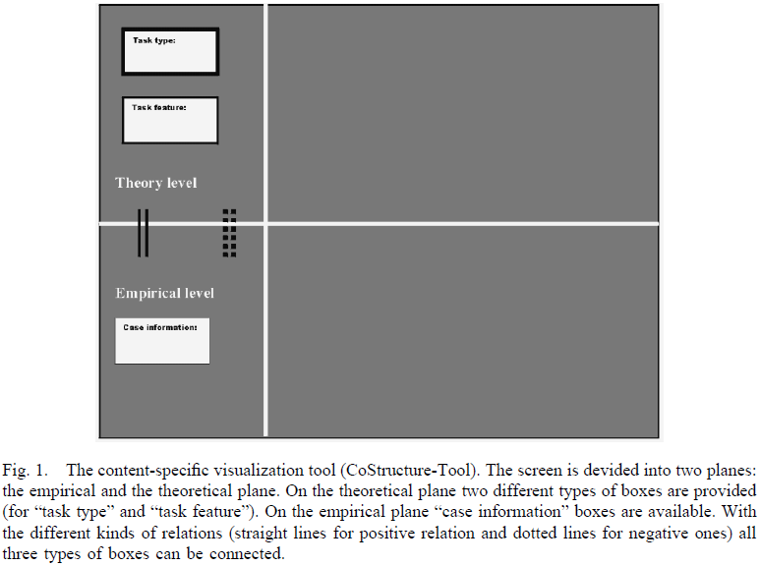
Method
2.Design and course of the study

Slide 21
Method
3.Measurement of collaborative construction of knowledge
Content of the collaborative construction of knowledge
Theoretical concepts
On Content
all off-task content
Case information
Other Content
Relation between case information and theoretical concept
operational coordination

Slide 22
Method
3.Measurement of collaborative construction of knowledge
Processes of collaborative construction of knowledge
Statements
Request for information.
Give requested information.
Suggestions.
Agreement
Rejection
Commissives
Directives
the coding scheme from Thomas et al. (1982)

Slide 23
Method
3.Measurement of collaborative construction of knowledge
An utterance with on-task content and the communicative function “request for information” or “directive” was categorized as elicitation.
Processes of collaborative construction of knowledge
Statements are utterances with the function of imparting information to the learning partner
Externalization
Elicitation
Conflict-oriented consensus building
Integration-oriented consensus building
Rejections of on-task content were categorized as conflict-oriented consensus building.
Agreements with on-task content were categorized as integration-oriented consensus building.

Slide 24
Method
4. Collaborative outcomes
(1) Appropriate use of theoretical concepts. To assess the appropriate use of theoretical concepts quantitatively we measured:
(a) The application of prior-knowledge concepts.
(b) Moreover, we assessed the application of theoretical concepts given in the learning environment.

Slide 25
Method
4. Collaborative outcomes
(2) Quality of the collaborative problem solution.
Low solution quality.
Rather low solution quality.
Rather high solution quality.
High solution quality.

Slide 26
Method
5.Group-to-individual transfer
1. Individual transfer of knowledge
2. Intragroup divergence of group-to-individual transfer

Slide 27
Method
6. Control measures
Preference of collaborative learning
Control measures
Operational coordination
Acceptance of the learning environment and motivation effects

Slide 28
Method
7. Unit of analysis
individual
questions 1 and 2
group
determine the individual transfer from collaborative knowledge construction according to research question 3
question 3

Slide 29
4
Chapter
Results

Slide 30
Results
1.Learning requirements and control measures
There are no differences between the groups regarding preference for collaborative learning.
The two groups show no differences regarding the mean total number of utterances.
There are no differences between the two groups in the amount of verbal effort spent on operational coordination.
No differences could be found concerning the acceptance item. The same is true for motivational effects of the learning environment.

Slide 31
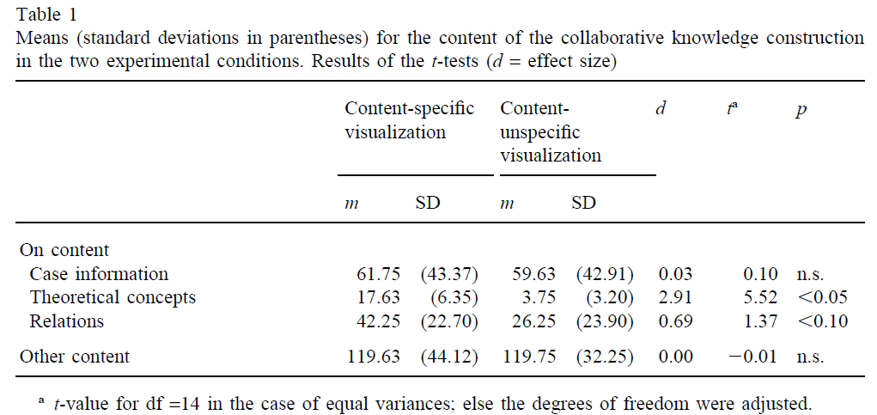
Results
1.Learning requirements and control measures
Results for research question 1
Content of the collaborative construction of knowledge.

Slide 32
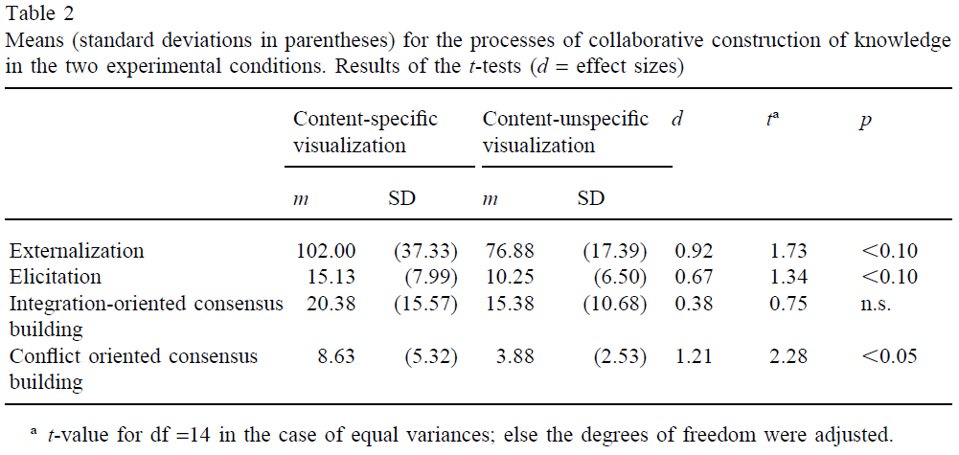
Results
1.Learning requirements and control measures
Results for research question 1
Processes of collaborative construction of knowledge.

Slide 33
Results
1.Learning requirements and control measures
The content-specific visualization tool influences the discourse of learners.
In this condition, more on-task content is introduced (particularly theoretical concepts);
Regarding the processes of collaborative knowledge construction more conflict-oriented consensus building as well as a tendency to more externalization and elicitation of on-task knowledge were registered.

Slide 34
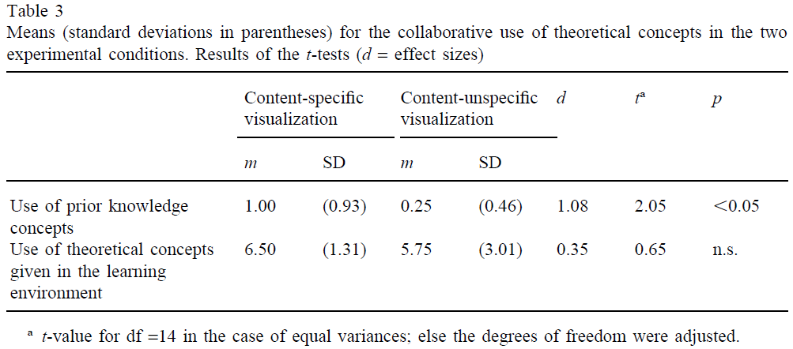
Results
1.Learning requirements and control measures
Results for question 2

Slide 35
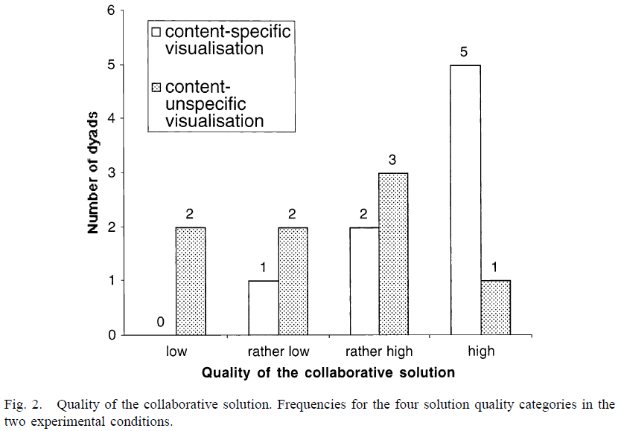
Results
1.Learning requirements and control measures
Results for question 2
Quality of the collaborative problem solution

Slide 36
Results
1.Learning requirements and control measures
Results for question 3
Concerning posttest mean values, the results for the content-specific visualization dyads are slightly lower as compared to the control dyads.
The analysis of the repeated measurements including pre- and post-test scores showed that the number of adequately used theoretical concepts significantly increased from pre- to post-test under both of the conditions.
The analysis of intra-dyadic divergence showed surprisingly clear differences between the conditions.

Slide 37
5
Chapter
Discussion

Slide 38
Results
1.Learning requirements and control measures
The content-specific visualization encourages the learning partners’ focus on the task-relevant content and increases the quality of the processes of collaborative knowledge construction.
This fosters the quality of the collaborative solution to a problem case.
The content-specific visualization leads to more equal individual learning gains within the dyads.
Content-specific active visualization techniques are an effective instructional support for collaborative knowledge construction.

Slide 39
THANK
YOU

